Slide 1
SIM- Data Infrastructure Subcommittee
April 16, 2014

Slide 2
Data Infrastructure Charge Statement
“The SIM Data Infrastructure Subcommittee will advise key projects and objectives within the scope of SIM towards improving data infrastructure systems and technology across the state of Maine.
Specifically, advising on technical capabilities related but not limited to data infrastructure investments, use of national data standards and clinical and administrative data availability and interoperability. The Subcommittee will advise the SIM partners and the Steering Committee on areas of alignment of SIM data and analytics infrastructure activities with other public and private projects underway across the State.”
2
Notes:
Elevator speech

Slide 3
Acronyms Used
ACO- Accountable Care Organization
BH/MH- Behavioral Health/Mental Health
BHH- Behavioral Health Home
CCT- Community Care Team
HIE- Health Information Exchange
HIN- HealthInfoNet
HIT- Health Information Technology
3

Slide 4
Agenda
Primary Meeting Goals:
Present HealthInfoNet’s (HIN) “Health Information Exchange Notifications Project”.
Receive feedback and input related to HIN’s Behavioral Health HIT Project (RFP) with particular attention to the complexities of mental health data sharing and consent.
4

Slide 5
Focus for feedback:
What is clear?
What is confusing?
What is the most important to understand?
Where is ‘support’ the most important?
Process effectiveness
Alignment and efficiency across SIM activities
5

Slide 6
Current Project Updates
Behavioral Health HIT RFP
26 applications scored; 20 approved applications have been notified of acceptance
April: Participant contracts with HIN distributed
Official launch of the initiative is slated for 5/13
Patient Portal- HIE Blue Button
Planning phase underway with EMHS
Official launch begins in June
6

Slide 7
Reminder: BH HIT Reimbursement Initiative Milestones
Adoption & Optimization of EHR
Connection to the Health Information Exchange
Sharing Data to Measure Quality
7
Notes:
Active goals also lifts barriers, and milestone achievements are written into the SIM HIE Program.

Slide 8
HIN’s SIM HIE Notification Project Overview & Education (Slides 8 - 29)
Project Highlights working with MaineCare:
Send MaineCare Care Managers medical record information about a specific group of their members, on behalf of the provider delivering the care (PHI released)
Information is focused on a subset of MaineCare members that may have high ER visit patterns as well as inpatient admissions. (Coordinated with hospital care managers)
Information flows by secure email from the HIE to the Care Managers
8

Slide 9
HIE Notification Project, continued
How HIN is supporting provider organizations with notifications today:
Providing emails to notify a health care providers (RN’s, CCT’s, Health Homes etc.) when specific real time events of care have occurred
Improving the functionality of the tool (“bulk patient load”, new events)
Educating about the HIE Service
9

Slide 10
Real-Time Event Notification
In July 2013, HIN deployed the use of email as a method to “notify” health care provider’s and their staff when a specific event had occurred related to any patient/provider participating in the HIE.
Provides a “push” tool directly to email
Supports rapid “real time” care coordination
10

Slide 11
Participation in Notifications
In order to participate in this HIN service a provider must be engaged in a active “Participation Agreement” (contract) for HIE services.
This includes both the bi-directional connection (sharing data directly) As well as the “view/download” connection
There are no additional costs for this service
11

Slide 12
What are the Notifications?
Notifications are emails containing a patient’s MRN (not PHI) that inform a designated healthcare professional that there has been a particular event associated with that MRN in the HIE.
Those receiving the notification would then access the HIE portal to retrieve the clinical PHI information association with the notification and any other related information in the HIE that is necessary.
12

Slide 13
What Events are Included?
Currently notifications can be linked to the events:
Emergency room admission and/or discharge
Inpatient admission and/or discharge
Skilled Nursing Facility (SNF) discharge
Laboratory use
Imaging use
13

Slide 14
Current use of Notifications
Real time information “that comes to you” is critical to the success of care coordination activities across the health care continuum.
Having real time access to ER and Inpatient discharge documentation improves the time and cost associated with these care coordination activities today.
The impact has already been very positive for Community Care Team panel managers, Family Medicine care managers, Oncology and Cardiology nurses.
14

Slide 15
Care Management Reimbursement Related to HIE Notifications
Medicare has approved two new CPT transitional care management (TCM) codes to reflect the non-face-to-face care management work involved in primary care.
Code | Required elements | Reimbursement in facility setting (approximate) | Reimbursement in non-facility setting (approximate)
99495 | Communication (direct contact, telephone, electronic) with the patient and/or caregiver within 2 business days of discharge Medical decision making of at least moderate complexity during the service period Face-to-face visit, within 14 calendar days of discharge | $135 | $164
99496 | Communication (direct contact, telephone, electronic) with the patient and/or caregiver within 2 business days of discharge Medical decision making of high complexity during the service period Face-to-face visit, within 7 calendar days of discharge | $198 | $231
Reimbursements began Jan 1, 2013.
CMS estimated that providers supplied the post-discharge TCM service for 5.7 million discharges in 2013, and AMA RUC estimates that 2 million of these codes are billed each year.
Notifications represent a FREE tool for providers to capture an estimated $600M + in eligible payments in 2014.
Sources: AAFP, “Summary of Proposed 2013 Medicare Physician Fee Schedule”, 12 July 2012, http://www.aafp.org/online/etc/medialib/aafp_org/documents/policy/fed/background/mpfs071212.Par.0001.File.dat/MPFS071212.pdf; American Medical News, “Medicare finalizes physician pay for new care coordination benefit”, http://www.ama-assn.org/amednews/2012/11/12/gvl11112.htm;

Slide 16
How to get set up with Notifications
For participants to begin using the Notification service:
Contact Rob Cook or Phil Profenno to begin the education and set up process: rcook@hinfonet.org, pprofenno@hinfonet.org
Once “set up”:
The provider site/practice identifies the list of patient’s (MRN, name etc.) that they wish to receive notifications on.
The kind of “notifications” are selected overall or by patient.
HIN provides a “bulk load” function for providers/practices.
Currently—for convenience any real time adds/deletes by patient can be done directly into the portal. This process will be reviewed during education and training.
16

Slide 17
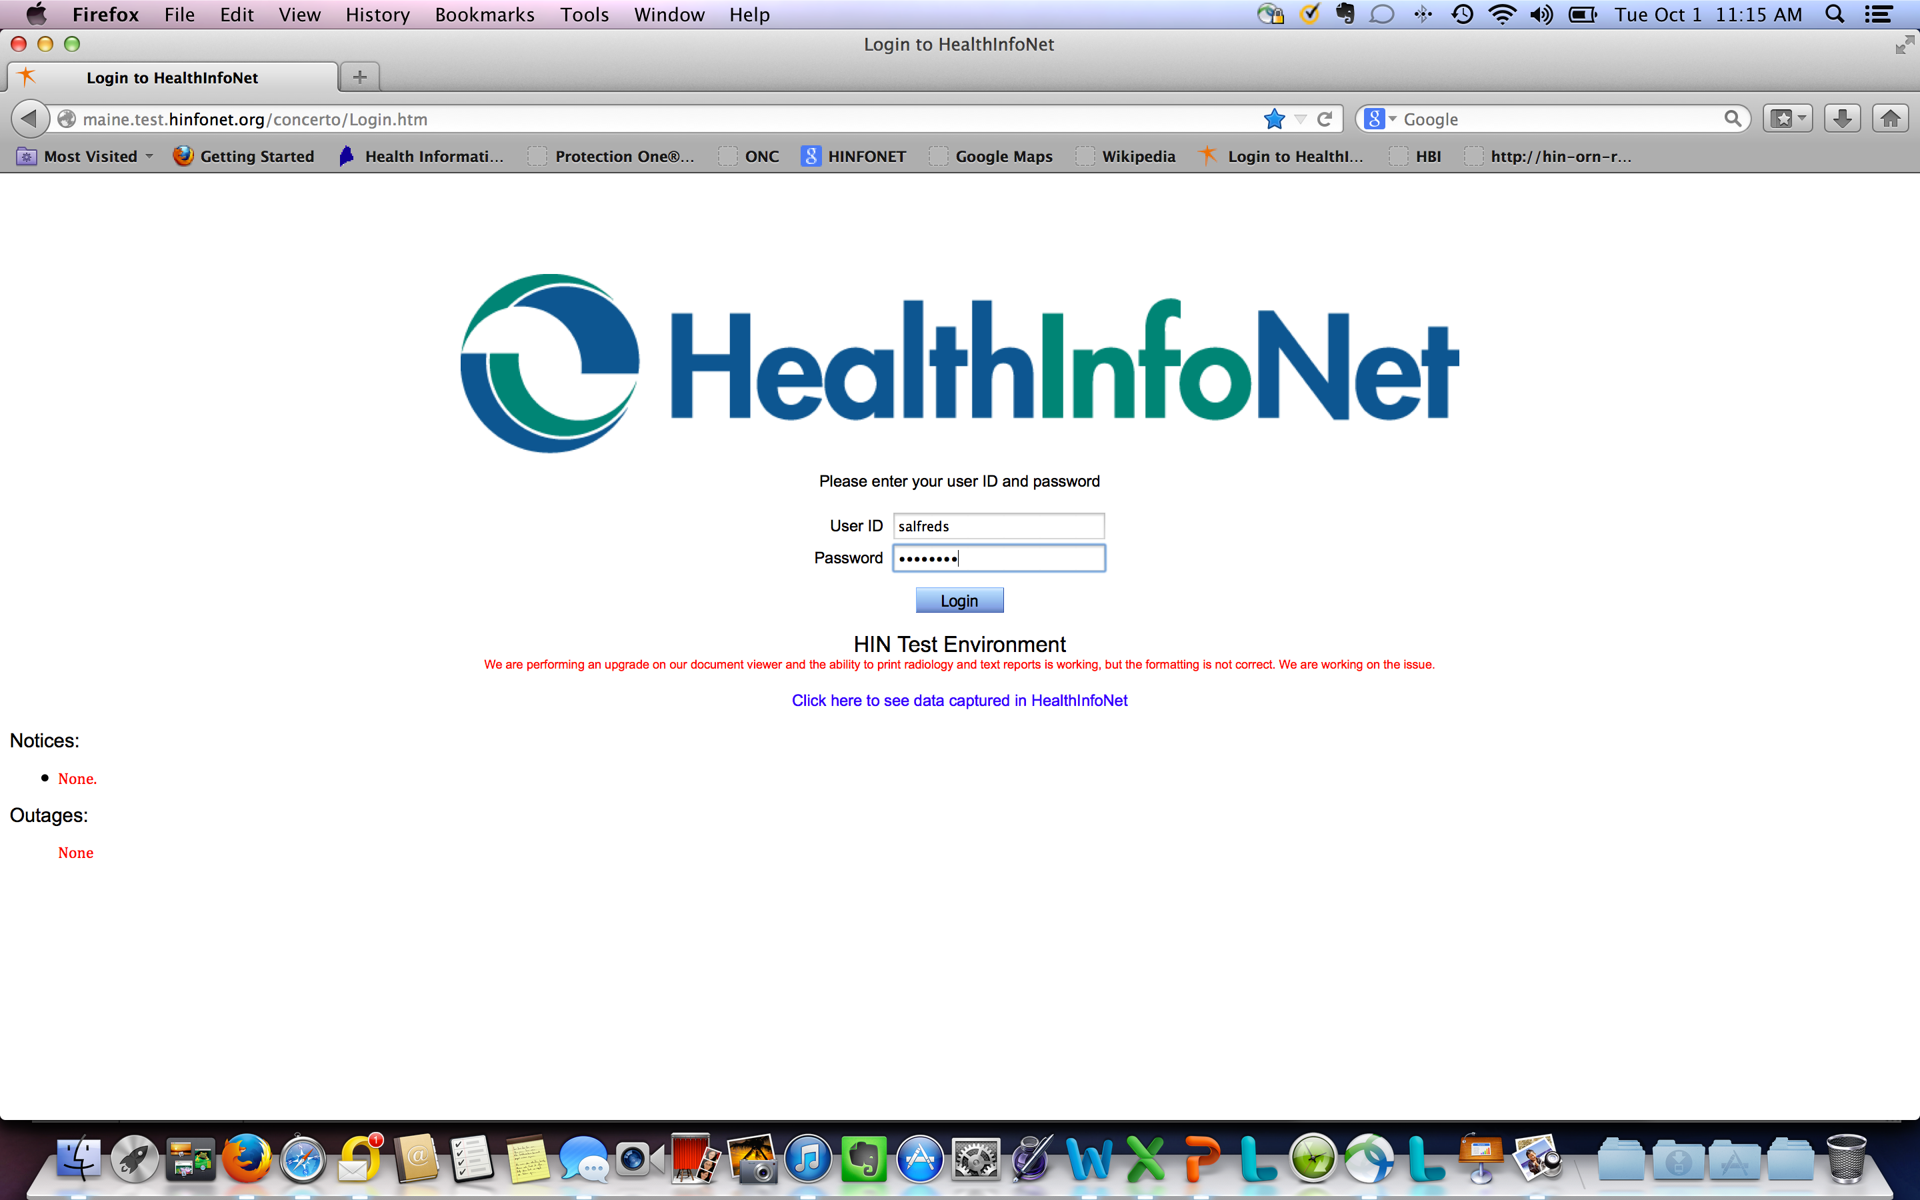

Slide 18
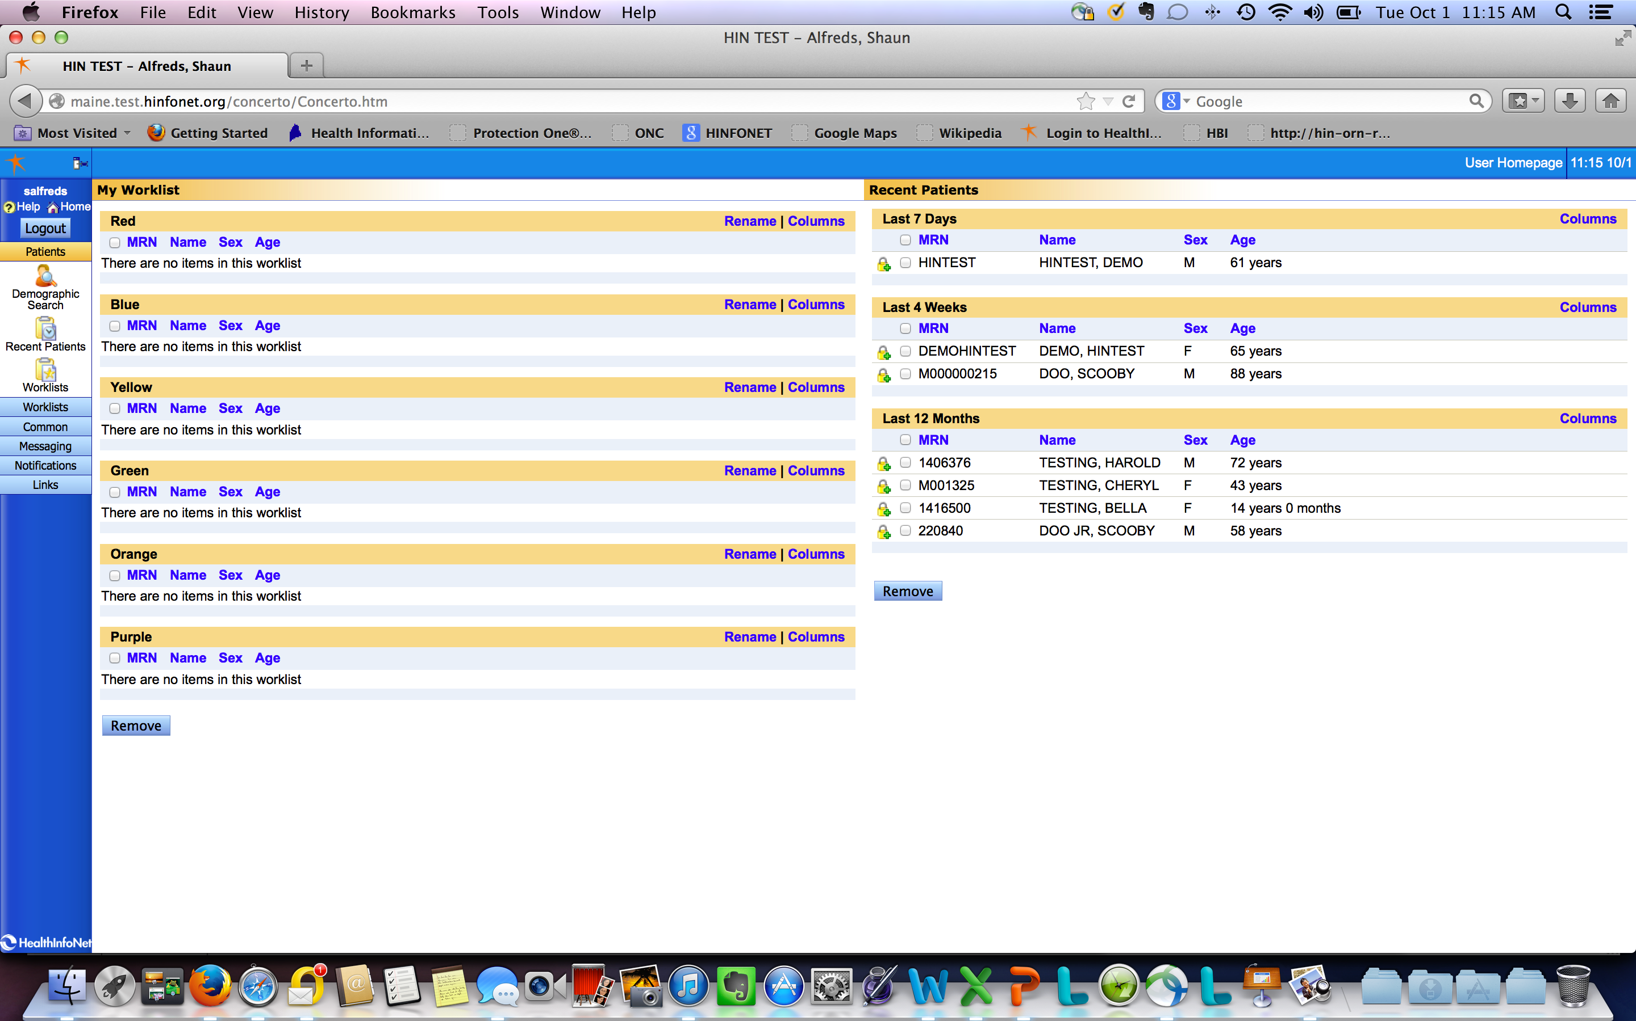

Slide 19
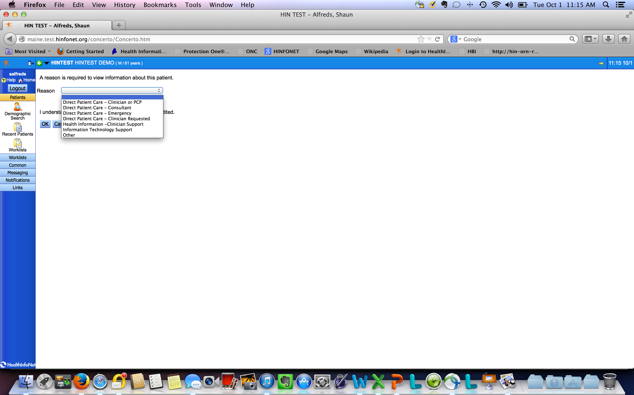

Slide 20
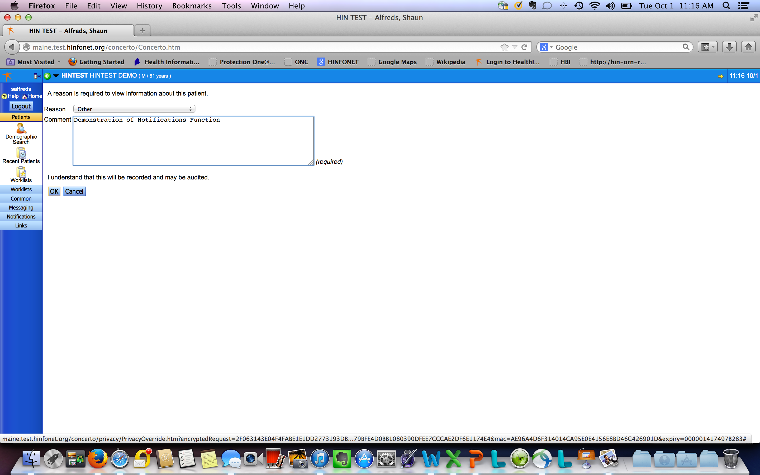

Slide 21
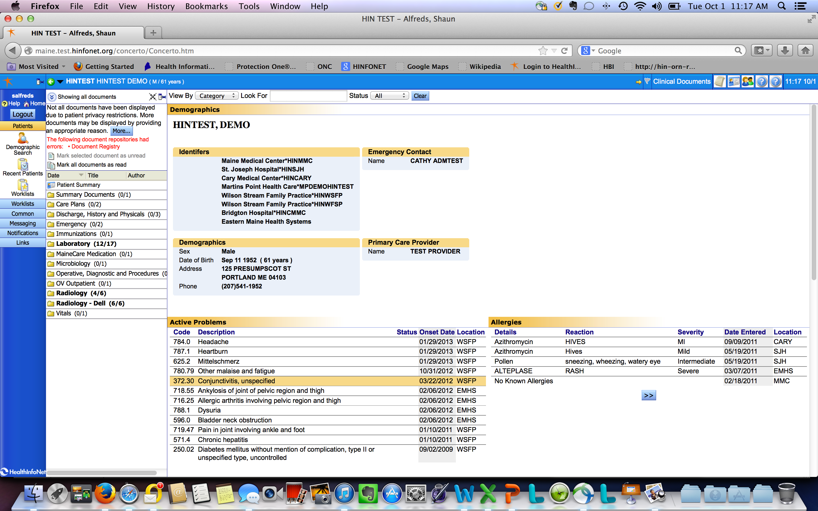

Slide 22
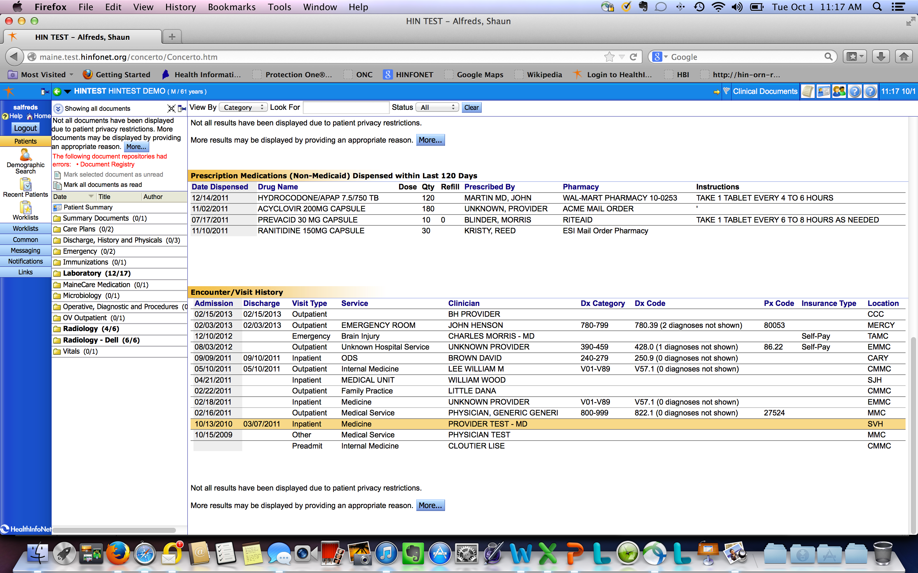

Slide 23
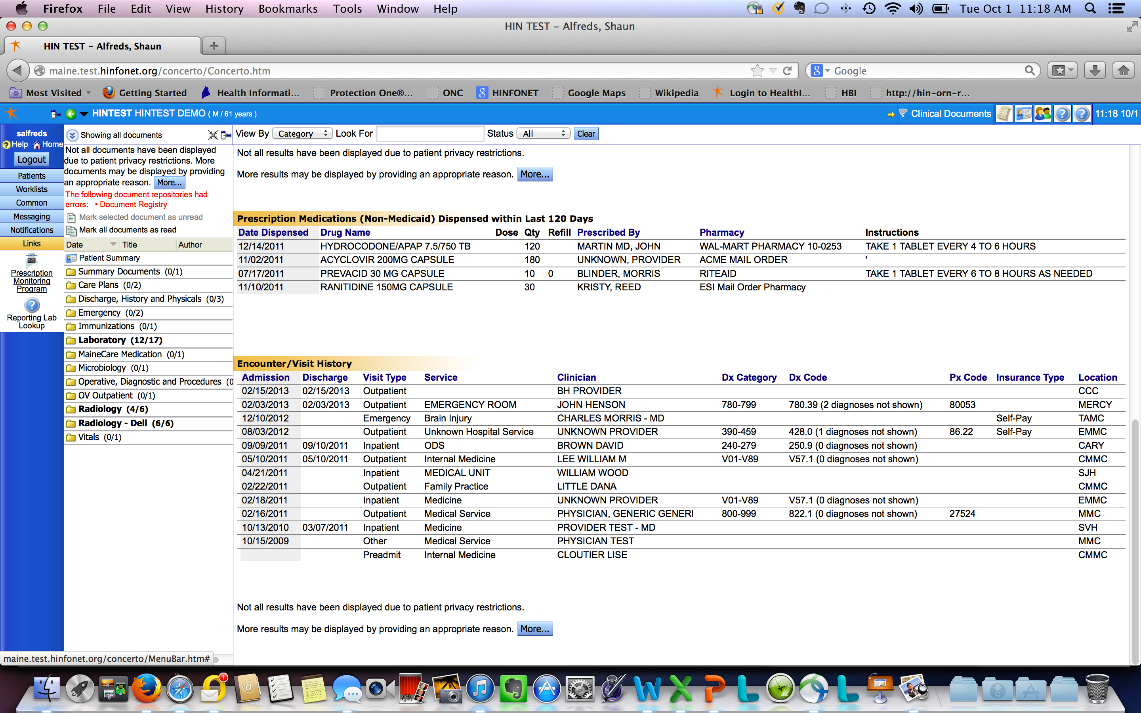

Slide 24
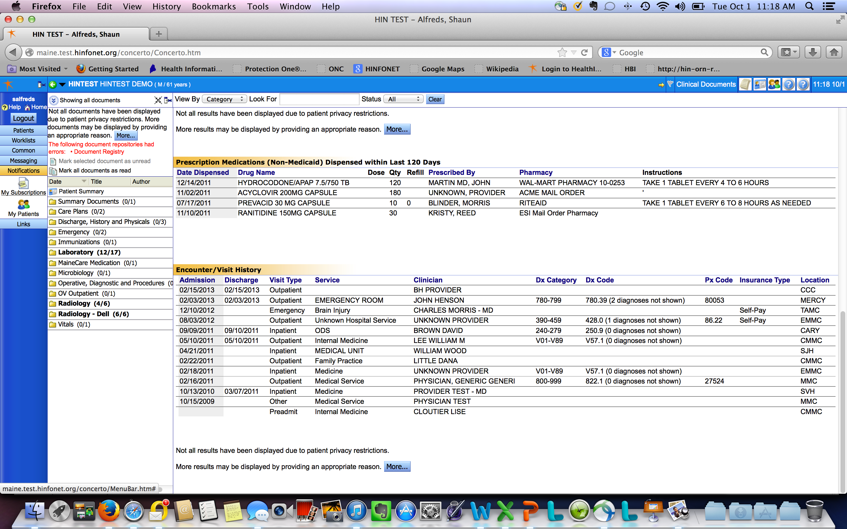

Slide 25
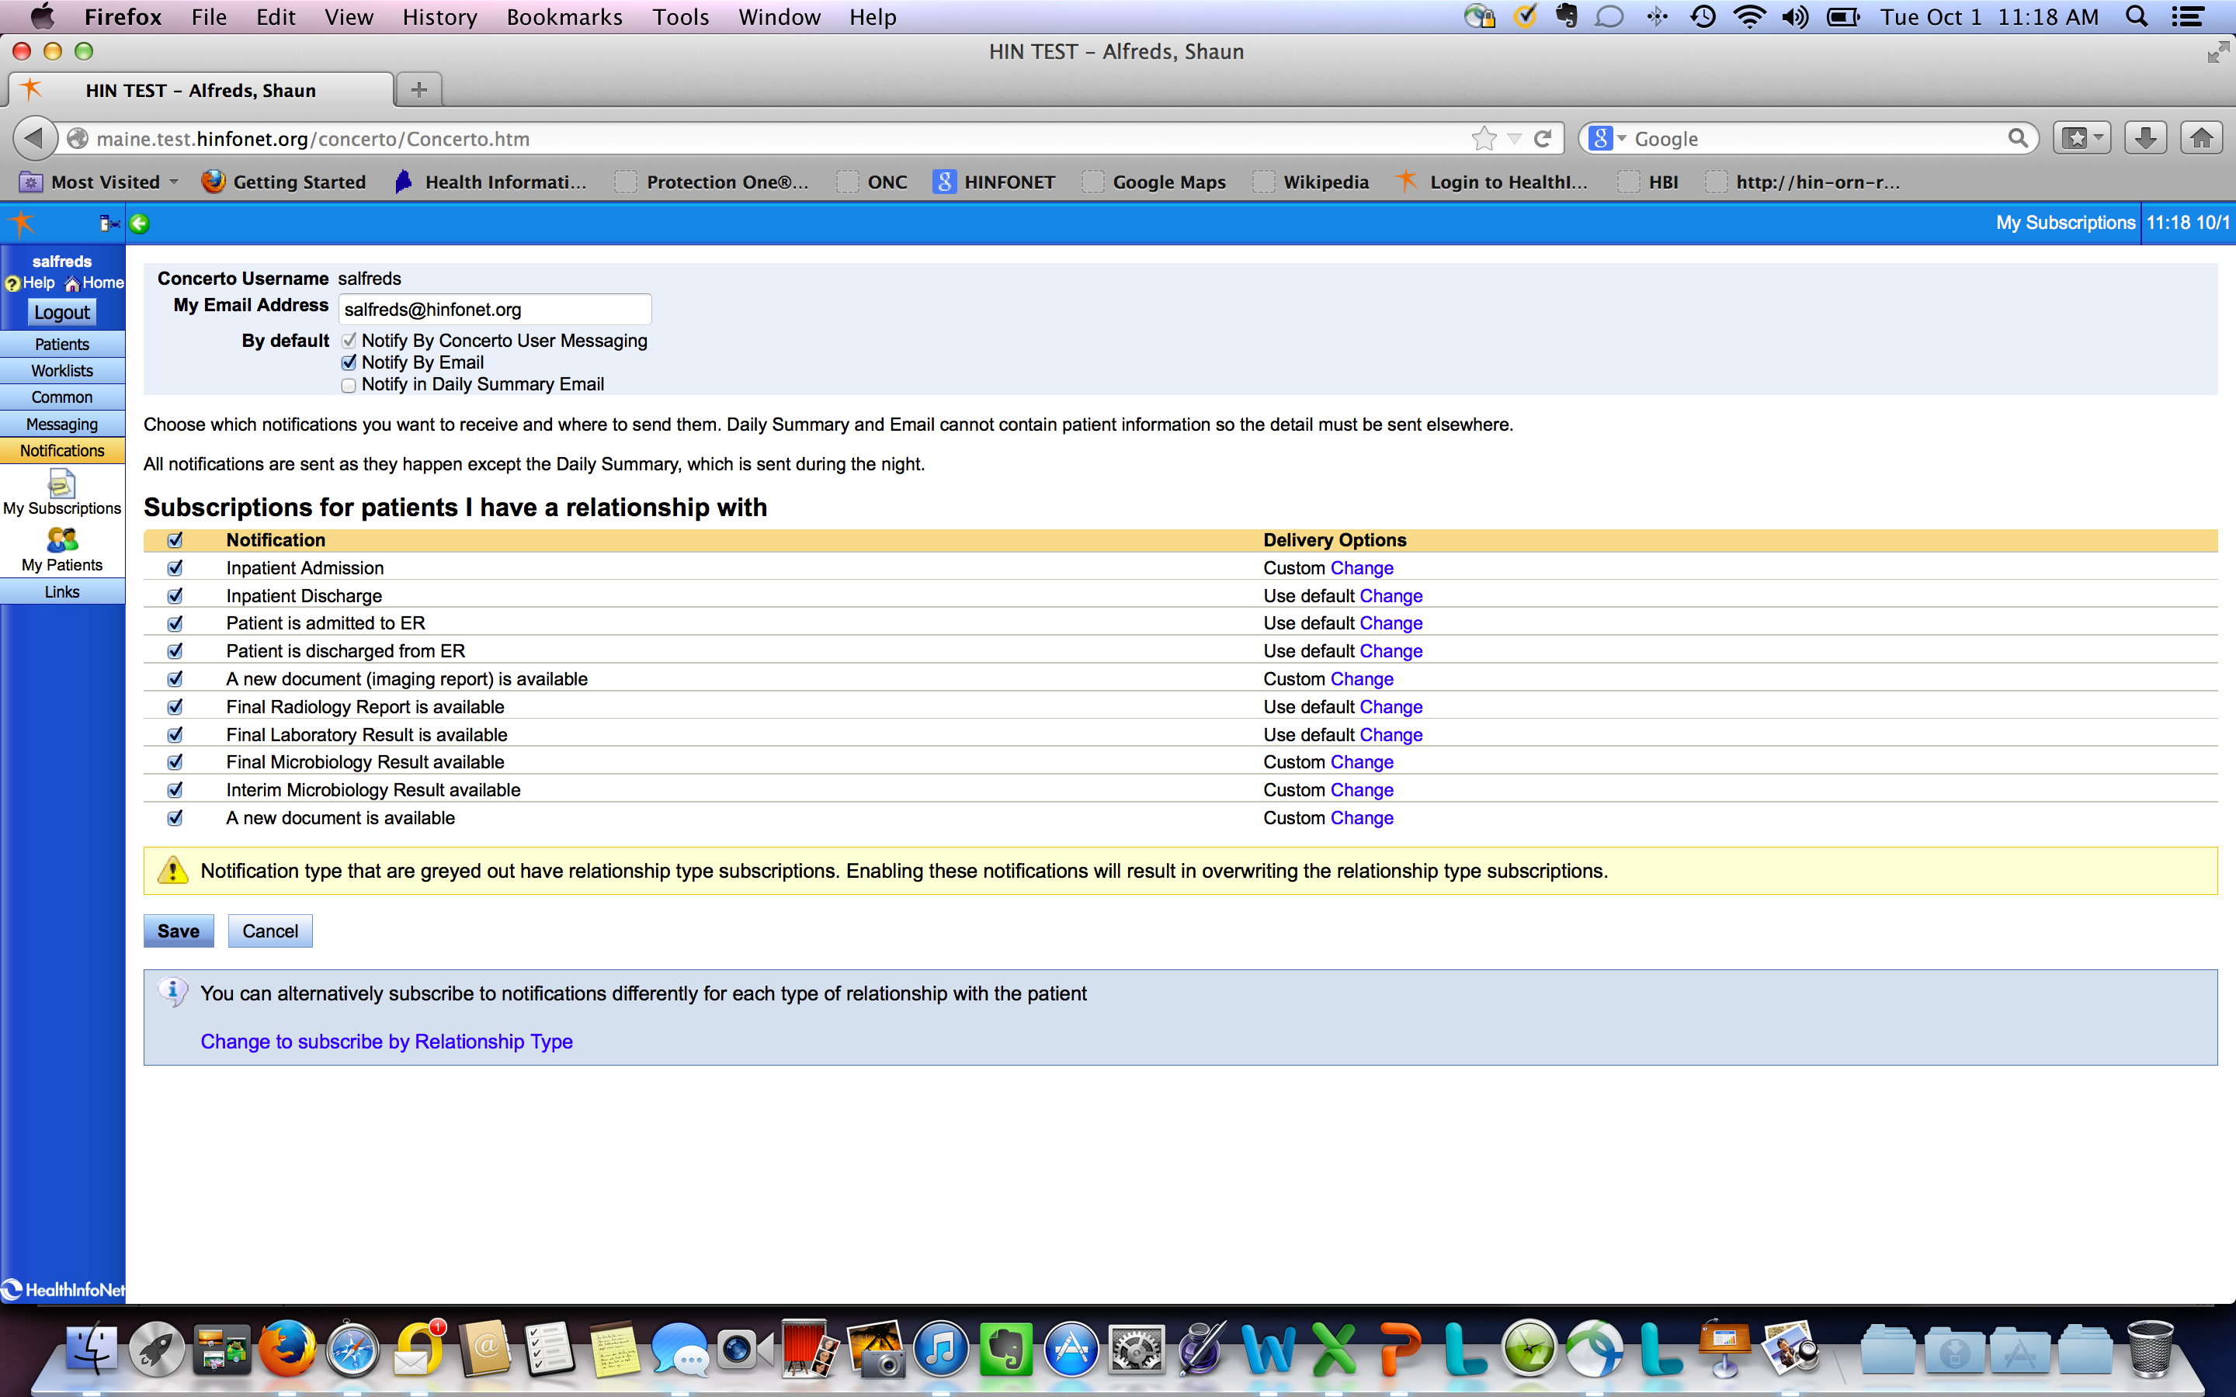

Slide 26
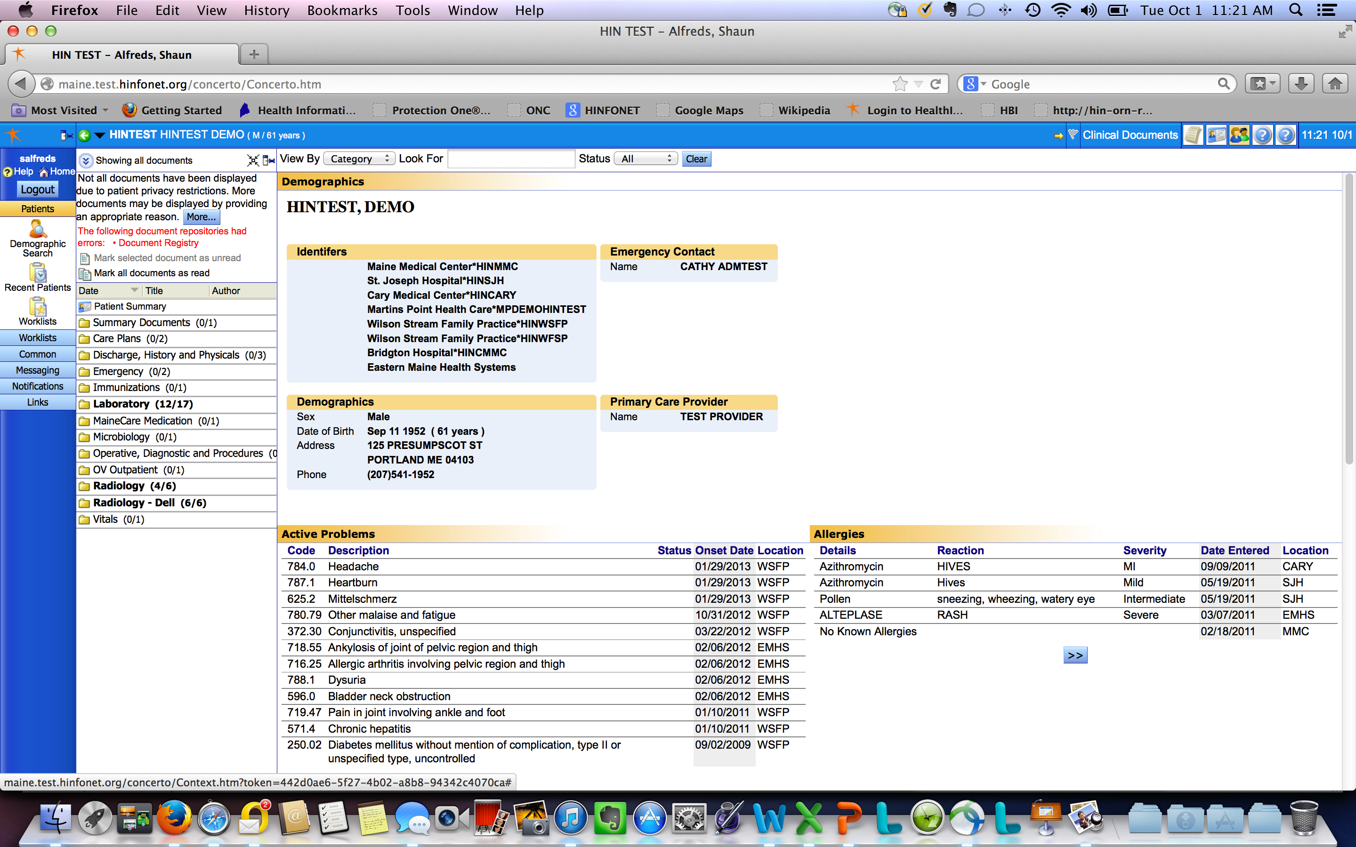

Slide 28
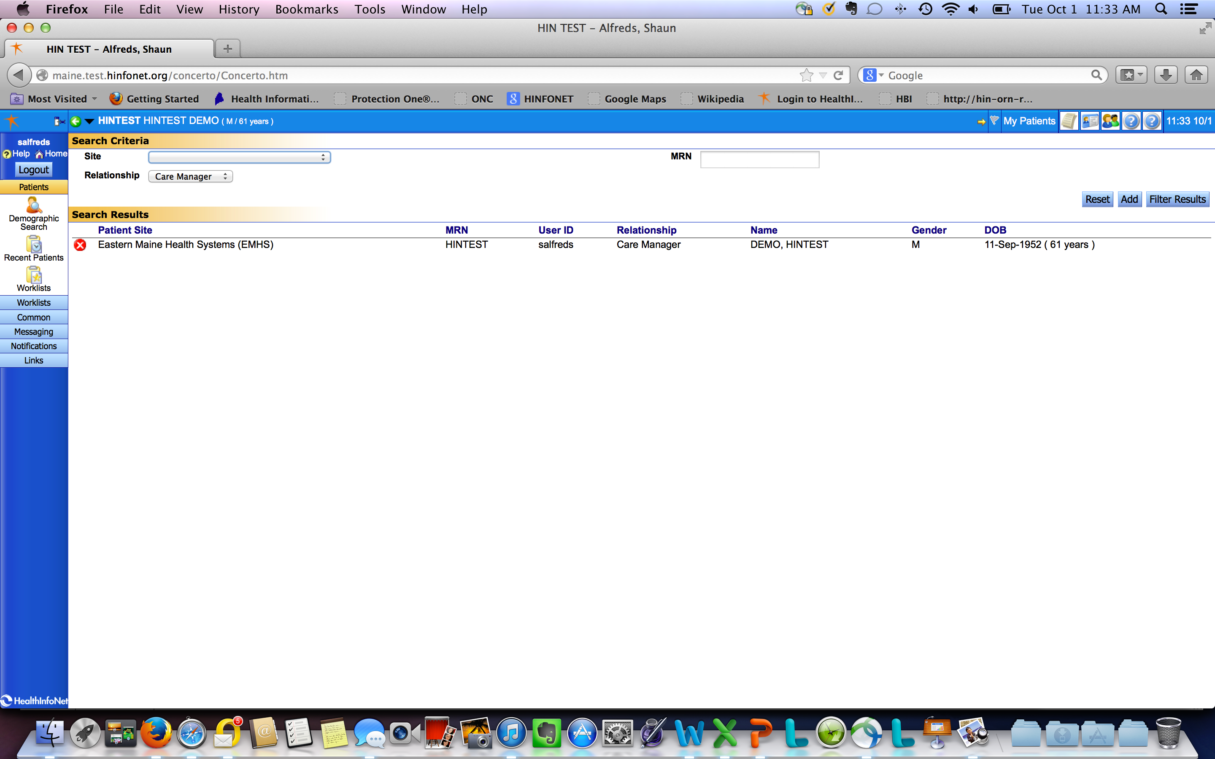

Slide 29
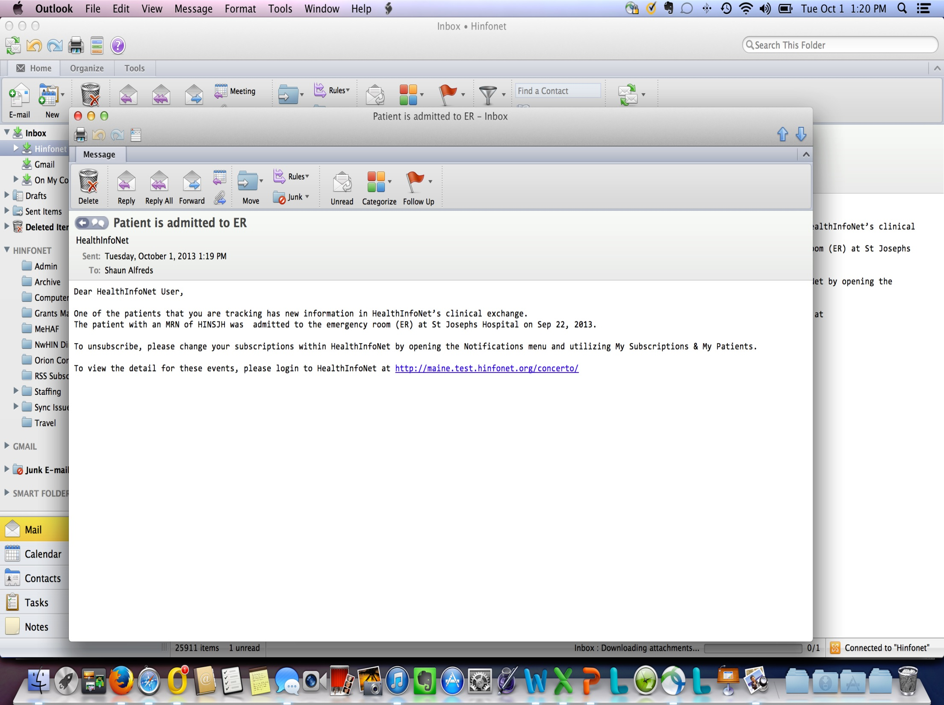

Slide 30
Behavioral Health HIT Project (RFP) Implementation Strategy- 1st 6 Months
Project Plan- timelines
Communication strategy
Collaboration- partnerships
Staff and Patient Education- development
Leverage “like” SIM Initiatives
Pathways to Excellence Behavioral Health Committee
Health Homes Learning Collaborative forums
Behavioral Health Homes forums (calls etc.)
30

Slide 31
Behavioral Health HIT Project (RFP)- Communication strategy
Goals:
Reduce burden
Make it feasible to attend
Balance with other SIM meetings
Use expertise of the group
Plans:
Monthly group calls- frequency? leadership vs. implementation teams
- 3rd Tuesday/month @12p
Sub workgroups within
Host webpage for group documents, message board, resources, etc.
Site visits
31

Slide 32
Behavioral Health HIT Project (RFP)- Collaboration- this is a partnership!
Throughout the communication process we will be:
Building relationships
Establish points of contacts
Reviewing plans and gathering feedback about needs
Learning about their operations (BH specific needs are different from general/medical)
32

Slide 33
Behavioral Health HIT Project (RFP)- Staff and Patient Education
We will be providing:
Technical & legal data structure education for staff:
How data is shared with HIN
What data is shared with HIN
Legal framework of sharing with a HIE
Patient consent communications
Consent options (clear tools, patient friendly)
Established vs. new patient workflows
33

Slide 34
Maine’s HIE/BH Data Infrastructure- Current State
Behavioral Health/Mental Health services and their EHR vendors vary by organization and determine…..
What patient health record information/data is available……
Which defines what data can be integrated and shared with a health information exchange….
34

Slide 35
Key Factors for Mental Health Data (Records) HIE Integration
Consent Processes
Maine Law for patient consent
General Medical vs. Mental Health & HIV data
Consent decree; Maine Law
24/7 Emergency Access to mental health data/records
Technical capabilities of health care providers and (health record technology)
Reporting requirements (MaineCare, Quality etc.)
Definitions of data as subject to mental health rules vs. substance abuse rules vs. general medical rules
35

Slide 36
HealthInfoNet Consent Policy for General Medical Health Information
Maine law requires HealthInfoNet follow an opt-out consent policy.
This policy was originally written in 2007 with input from stakeholders representing patients, providers, employers, payers, and government.
Consumers opt-out online, on paper, or over the phone.
Consumers opt-out once for all care locations at which time their clinical data is deleted, not just hidden.
Patients can opt back in, however their records will start from that day forward. The system does not go back.
36
Notes:
HealthInfoNet is prepared to take this one, with consent policies in place per Maine Law.

Slide 37
HealthInfoNet Consent Policy for General Medical health Information: Patient Education
Per Maine State law, participating organizations must:
Give opt-out form to all patients at point of initial contact” following connection to HealthInfoNet.
Send any signed opt-out forms to HealthInfoNet within 2 business days OR provide a way for patient to opt-out at no cost to the patient.
37
Notes:
We provide communication tools to our healthcare organizations in compliance with Maine Law.

Slide 38
Mental Health, Substance Abuse, and HIV Health Information
Until a recent state law change (out of LD1331) the following information could not be included:
Information created by a licensed mental health provider
Mental health diagnoses
HIV diagnoses and results of HIV tests
Revisions to State Law in 2011 – Allowing MH Information Sharing and consent for full access within HIE
Changed the definition of Release to “Access”
Allows HIE to collect information as long as it is managed differently than general medical information
HIE responsible for providing “Opt-In” consent mechanism
Allows for a broader discussion of Substance Abuse
38
Notes:
And we comply with recent changes to Maine Law regarding Mental Health Information.

Slide 39
Technical Implementation for Consent to Share Mental Health within the HIE
HealthInfoNet’s Technical Architecture
Mental health data is sent by the provider EHR to the HIE data structure and is sequestered and managed differently* than general medical data.
Audit functions are in place to automate monitoring of MH access.
“Break-the-Glass” tracking functionality is in place for each “access” of the sequestered data.
*see consent options on next slide
39
Notes:
And we have the technical infrastructure to comply with Maine Law regarding the Opt-In consent for Mental Health.

Slide 40
Technical Implementation for Consent to Share Mental Health within the HIE
Opt-in consent mechanisms
Option 1: Patient chooses to opt-out all information.
Option 2: Patient chooses not to opt-in; but gives consent for a provider (HIE user) “to break the glass” at that point in time. Sequestered data is available behind the “break the glass” for emergency access.
Option 3: Patient chooses to opt-in mental health/HIV data to make this sensitive information available to all providers using the HIE (no break the glass required).
40

Slide 41
True or False?
Build it, and they will come.
41
Notes:
In Maine, we have the Health IT structure in place for BH organizations to integrate health care into the BH care of their patients, but having the ability to take in MH information and getting the information from MH providers is not the same thing.

Slide 42
BH & HealthInfoNet’s Health Information Exchange- by the Numbers
In 2012 (upon new Law implementation):
HealthInfoNet offers View-Only Connection to 25 BH Organizations
View-Only Connections as of 2014:
6 behavioral health organizations are connected to HealthInfoNet
2 mental health hospitals are connected
Active Users as of 2014:
Out of these 8 organizations, there are 11 active users (compared to over 10,000 users from general medical organizations)
In first quarter of 2014 there have been 195 patient accesses by these 11 users
42
Notes:
At the end of 2012, a grant through SAMSHA allowed HealthInfoNet to offer free connection to the HIE, so cost wasn’t a barrier, but the interest wasn’t there, as indicated by the low numbers…, but that’s changing.

Slide 43
Maine HIE/BH Data Infrastructure- The Transformation
What is it going to take to integrate mental health and general medical health data??
43

Slide 44
Employers & Insurers
Hospitals & Health Systems
Doctors and Health Providers
Safe
Coordinated
Data Driven
Integrated Health Information Model
Benefit Design
Care
High Quality
MaineCare Data
HealthInfoNet Statewide Health Information Exchange
Commercial Prescriptions
Other Data Providers
Participating Laboratories
Provider EMRs
Provider EMRs
HIE Participant Patient Portal Connection
Empowered
Healthy
44
Patients
People

Slide 45
Push for change: new models of care/payment require HIT & Data Integration
BH Organizations now need the ability to:
Pool and share data across providers and care settings (care coordination/shared accountability)
Have access to real time health record data
Leverage an infrastructure that goes beyond the EHR (i.e., ED notifications) to support quality improvement, measurement of impact etc.
45
Notes:
To be useful, data needs to be more than an EHR; it needs to be fluid, and Maine’s HIE provides a solution.

Slide 46
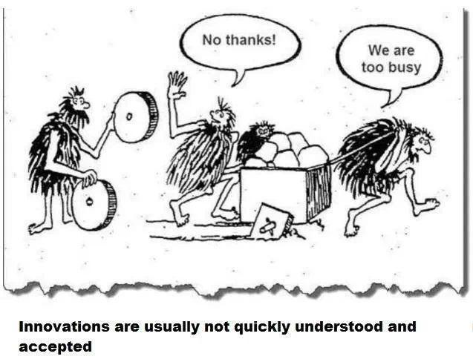
46

Slide 47
A Cultural Shift; for example
A change from holding data in information silos to fluid sharing of data.
The Dichotomy of
- Serving Clients’ Needs through Privacy AND
- Advocating for Clients’ rights to include their Health Information in the HIE
47
Notes:
But exchanging mental health information is a change from the way “we’ve always done things,” and requires a cultural shift.

Slide 48
It’s Going to be a Heavy Lift…AND
48
Notes:
it’s going to require the staff to provide extensive outreach to patients, and for clinical providers and team members to change their workflow and use the data in HIE to support integration of care for their patients.

Slide 49
Knowledge Lifts Barriers…
Education for patients
Education for staff
Education about HealthInfoNet and HIE
Knowledge about
- Legal issues
- How and when data is available
- Expectations and limitations of HIE
Recognize the culture change
Group learning and sharing, etc.
49
Notes:
But knowledge can help to lift barriers that make the cultural shift possible. (Lynn and Margaret may want to speak of the challenges and strategies)

Slide 50
Bring certainty & mutual understanding
Source: R. Stacey, Zone of Complexity, 1996
50

Slide 51
It takes a village; it takes you!
Open for discussion and feedback:
What is clear?
What is confusing?
What is the most important to understand?
Where is ‘support’ the most important?
Process effectiveness
Alignment and efficiency across SIM activities
51
Notes:
And also having the tools to implement the change helps to lift barriers to change.

